Slide 1
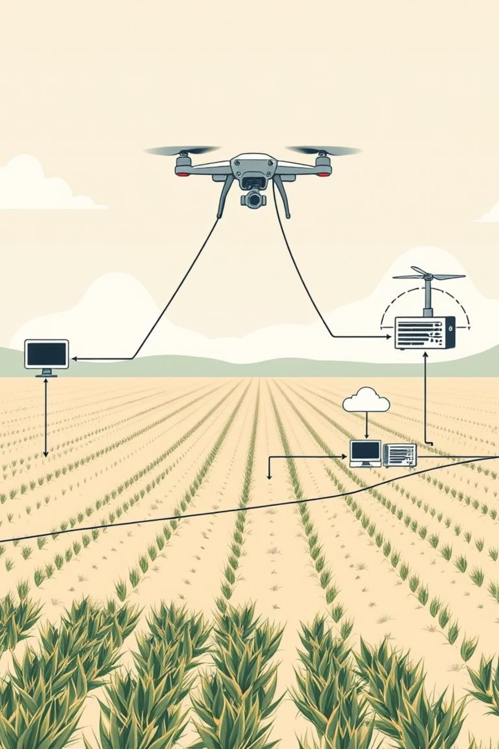
Enhanced Presentation: Automated IIoT Service Deployment Using MEC in Drone-Assisted Smart Agriculture
Project Title: Automated IIoT Service Deployment in Drone-Assisted Smart Agriculture Using MEC APIs
Done by
CB.SC.U4CSE23260
CB.SC.U4CSE23241
CB.SC.U4CSE23265
CB.SC.U4CSE23250

Slide 2
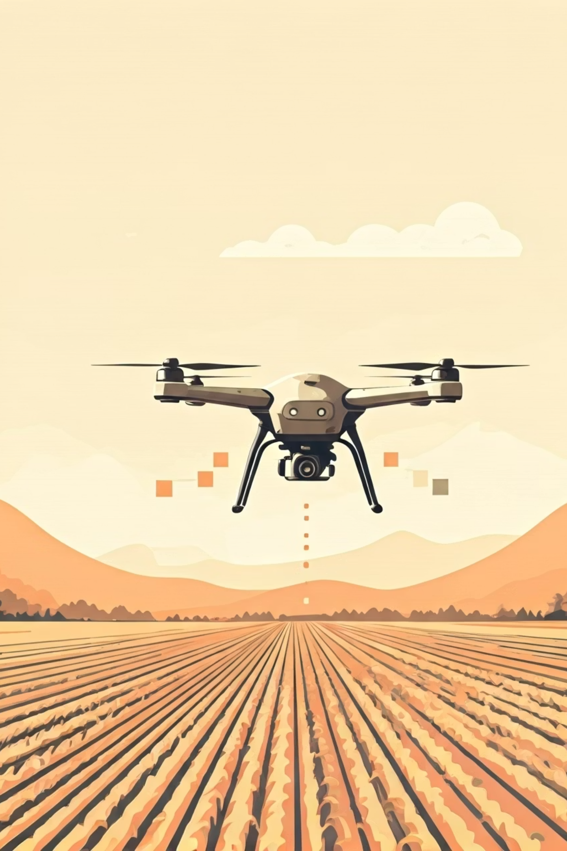
The Challenge: Why Edge Computing is Critical for Agricultural Drones
Real-time Decisions
Bandwidth Constraints
Immediate data processing for precision spraying and rapid disease detection.
Remote agricultural areas often lack robust, high-bandwidth network infrastructure.
Offline Operations
Reliable functionality even when cloud connectivity is intermittent or unavailable.

Slide 3
The Challenge: Why Edge Computing is Critical for Agricultural Drones
Agriculture increasingly uses drones for real-time crop monitoring, soil analysis, and pest detection.
Task Splitting:
Raw sensor data from drones needs immediate analysis to enable on-the-fly decisions.
Edge:
Run object detection and image classification on the drone itself or nearby field unit
Relying on cloud-only processing introduces unacceptable latency for time-sensitive agricultural responses.
Fog:
Regional analysis (e.g., per field), workload coordination
Cloud:
Long-term data storage, dashboard reporting, yield forecasting

Slide 4
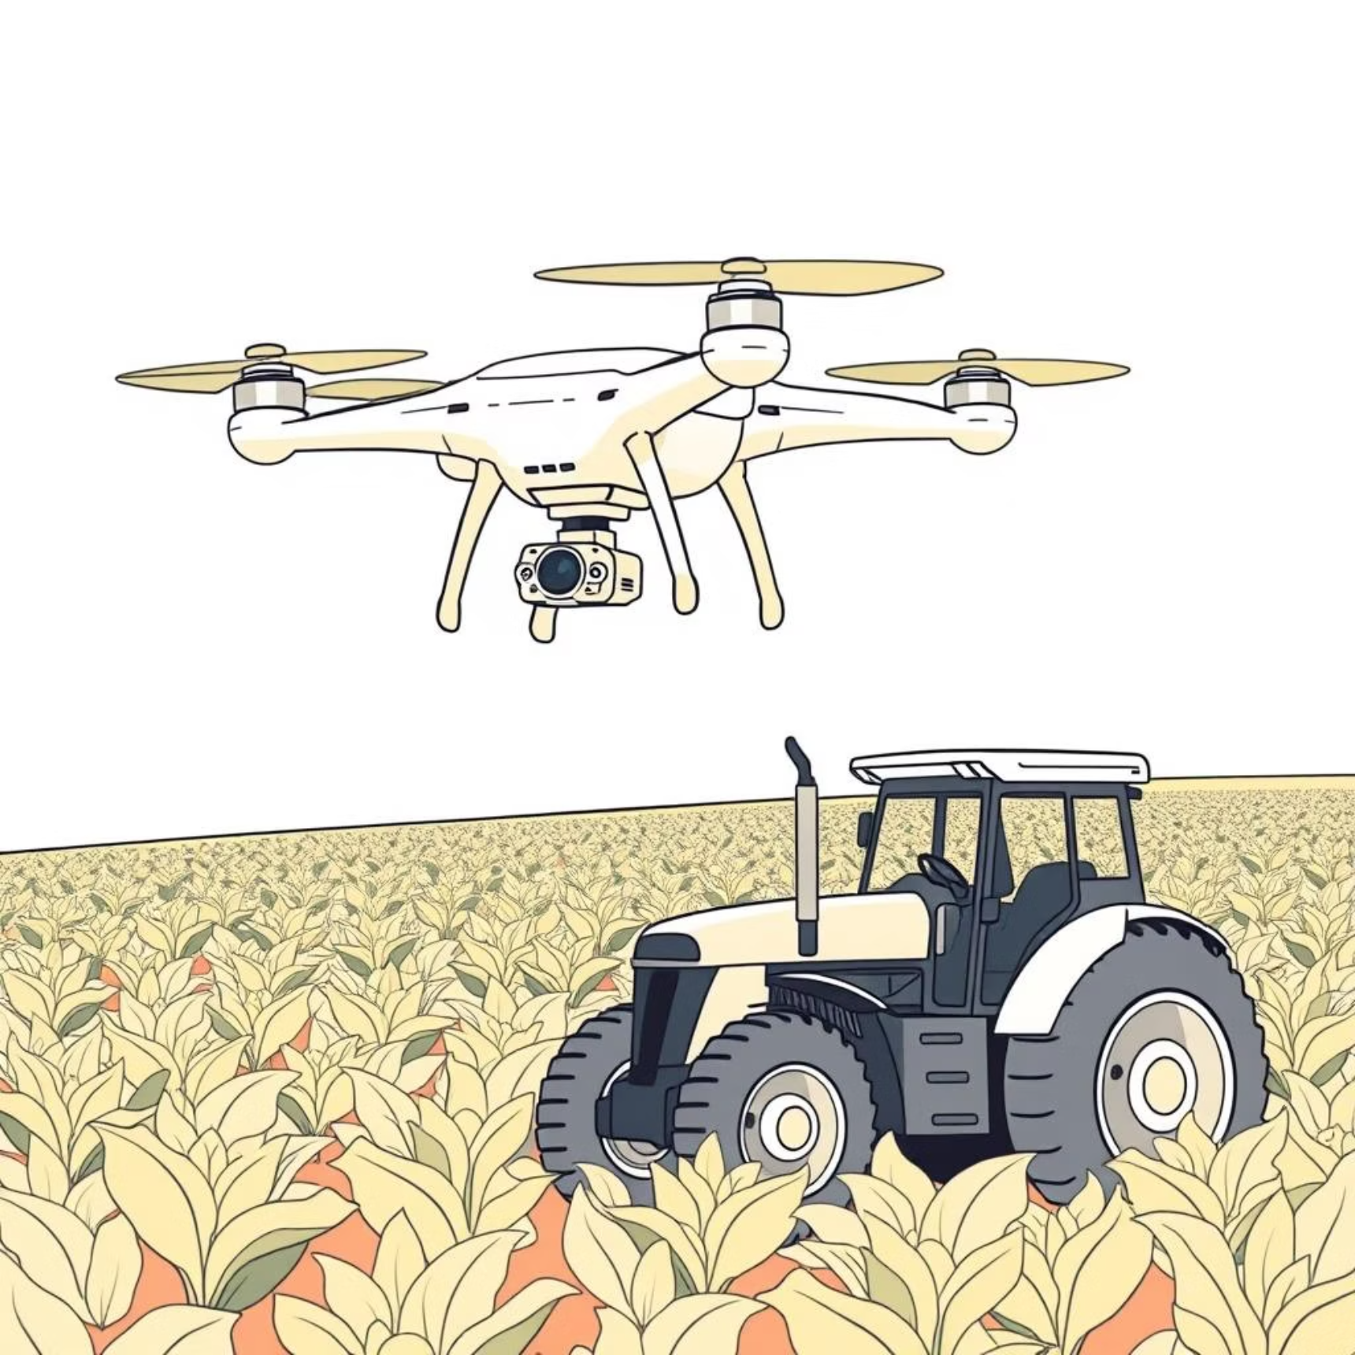
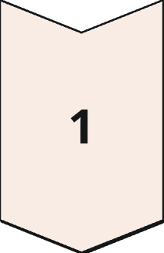
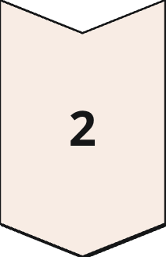
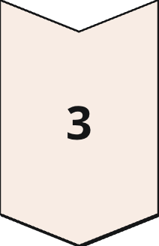
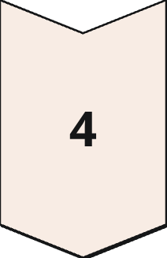
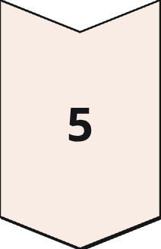
A Real-World Analogy: Drones in the Field
Detection
A drone flying over a crop field detects discoloration in plants suggesting disease.
Edge Processing
An edge processor onboard the drone runs a model to identify the issue.
Fog Node Takeover
If the drone is overloaded or offline, a fog node on a nearby tractor or base station takes over.
Cloud Upload
Results and raw data are uploaded to the cloud for agronomists and dashboards.
Immediate Decisions
Immediate, localized decisions ensure better crop health and reduce losses.

Slide 5
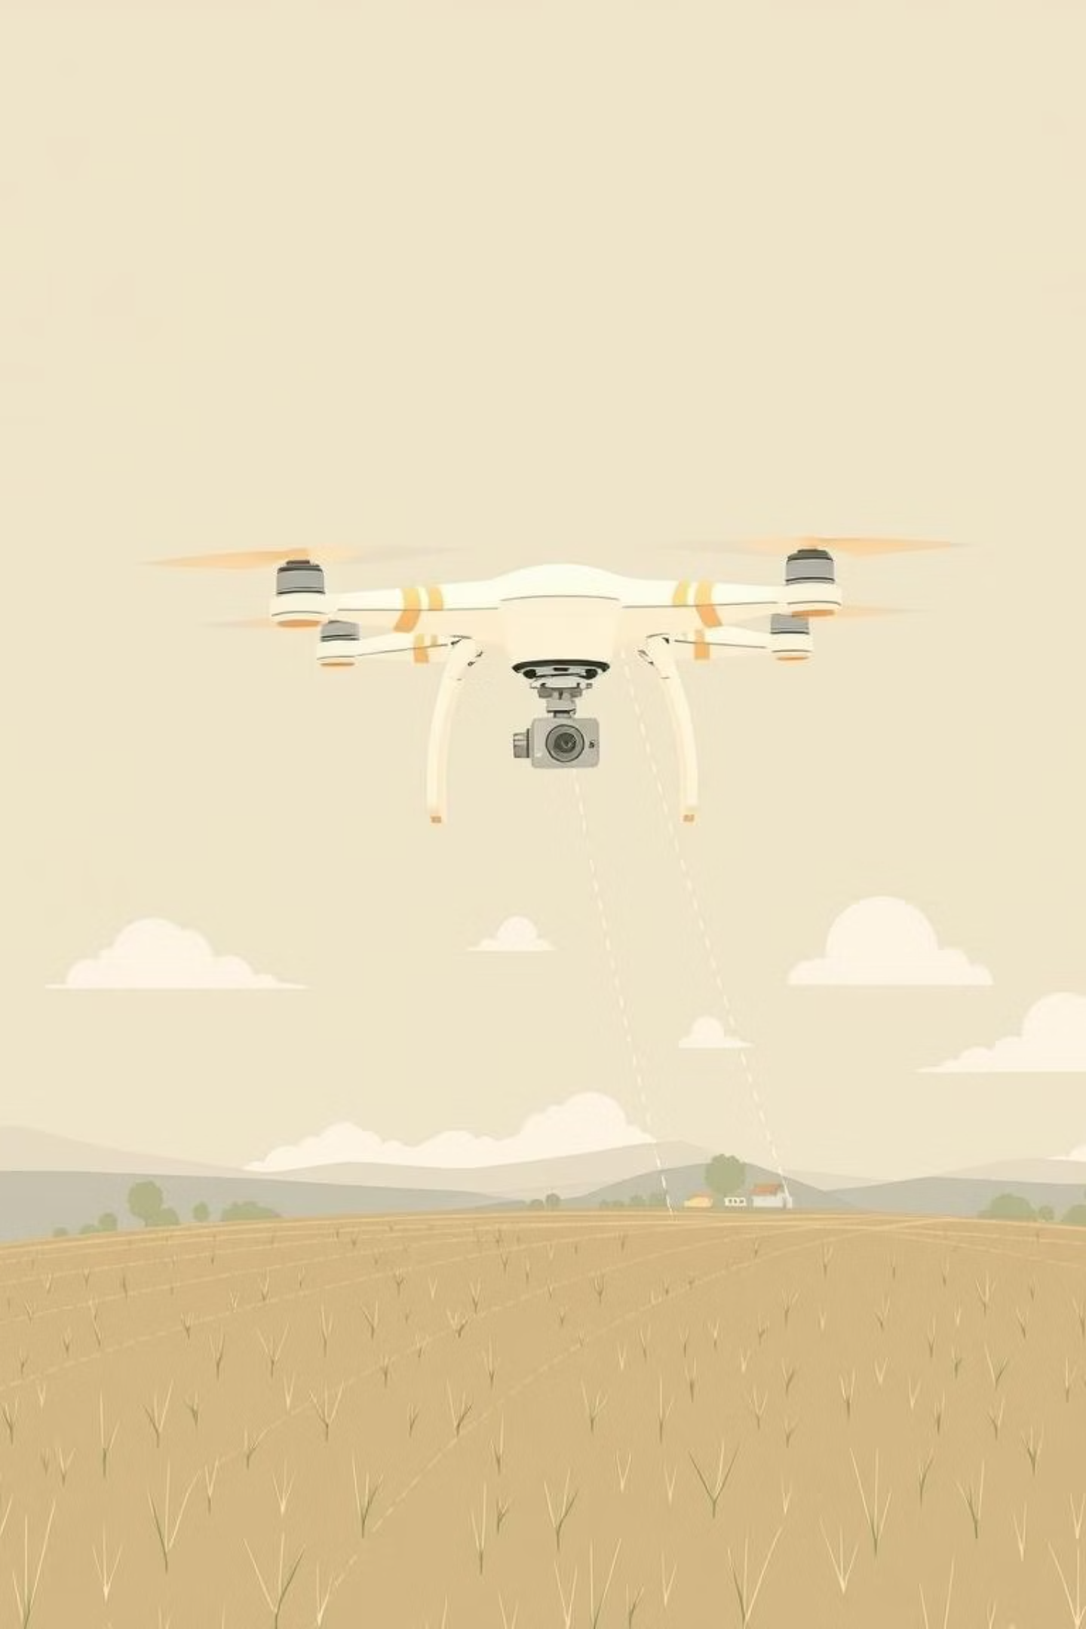
Project Objective
Simulate a smart agricultural ecosystem with drone-based data generation.
Implement MEC-style orchestrator to manage dynamic service deployment.
Goals: Ensure low-latency processing, adaptive service placement, and efficient resource use.

Slide 6
System Architecture
Level 2: Edge Layer
Level 1: Physical World
Onboard drone processors or mobile base stations in the field
Drones and ground sensors monitoring crop and field conditions
Level 4: Cloud Layer
Level 3: Fog Layer
Central agricultural cloud service for storage and planning
Regional farm hubs or tractors with higher compute capacity
Software Services:
AnalyzeCropHealth: Lightweight service to process visual or spectral data
LogObservation: Sends summaries to cloud for traceability

Slide 7
YAFS Simulation Setup
YAFS models agricultural field topology
Sensor Nodes:
Simulate drones generating periodic images/data
Edge Node:
IPT = 3,000; Latency = 5ms
Fog Node:
IPT = 6,000; Latency = 15ms
Cloud Node:
IPT = 10,000; Latency = 50ms
Workflow:
Sensor → AnalyzeCropHealth → LogObservation

Slide 8
MEC-Orchestrator Logic
The orchestrator automates service deployment based on real-time drone data, ensuring optimal performance in dynamic agricultural environments.
Criteria for Deployment:
Latency
CPU Load
Node Power
Prioritizes proximity to the drone or field station for immediate responses.
Considers the processing demand on available nodes to prevent overload.
Accounts for power availability, especially crucial for drone-mounted or remote nodes.
Deployment Priority:
1
2
3
Edge
Fog
Cloud
(onboard drone/base station)
(tractor/farm control unit)
(fallback only)
This intelligent orchestration enables immediate, location-aware agricultural decisions, optimizing resource utilization and operational efficiency.

Slide 9
Team Contribution Split
1
2
Danvanth:
Prithiv:
Designed MEC-based orchestration logic
Configured the YAFS simulation environment and defined the agricultural drone topology
3
4
Vivin:
Nirvesh:
Collected performance metrics and produced visualizations (graphs, tables)
Implemented the placement algorithm in Python
Conclusion & Key Takeaways
1
MEC-style orchestration improves drone efficiency in agriculture
2
Reduces decision delay for time-sensitive crop conditions
3
Validates edge-first strategies for robust, scalable agri-tech deployments

Slide 10

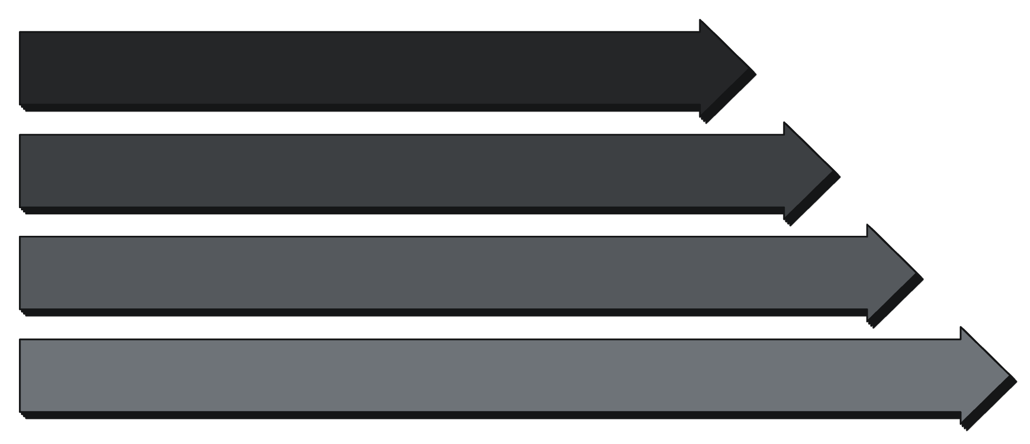
Backup – Q&A
Quick Summary: This project simulated a smart agriculture setup using drones and MEC-based orchestration to automate IIoT service deployment. The orchestrator intelligently chose between edge, fog, and cloud nodes to minimize latency and balance workload. Results showed significant improvements in responsiveness and resource use.
Timeline Diagram:
Drone Sensor
Edge
Fog
Cloud

